Slide 1
Regression of Used Car Prices
Kaggle competition

Slide 2
Quick Introduction
01
02
03
04
05
06
Reading data and Discovering general information
Cleaning Data
Visualizations and Heatmap
Feature Engineering
Machine Learning
Accuracy

Slide 3
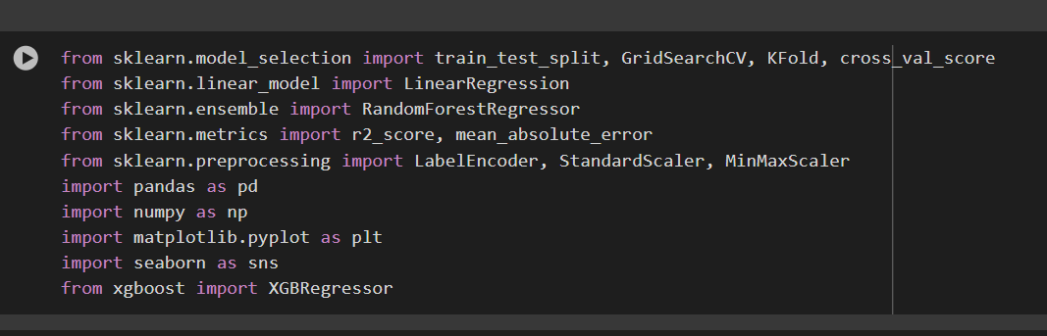
Importing Libraries
As a starter we imported those libraries :
Machine Learning
Pandas
Numpys
Visualization

Slide 4


01
Reading data and Discovering general information

Slide 5
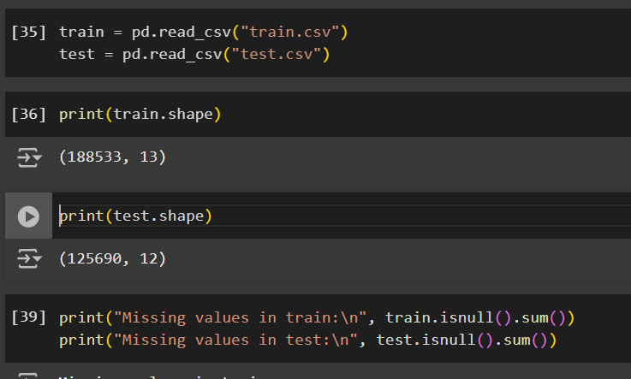
We read the csv files and used the (.shape) function so we can know the number of rows and columns in each dataset
Lastly here we used the (.isnull().sum()) function to discover any null/missing values in dataset

Slide 6
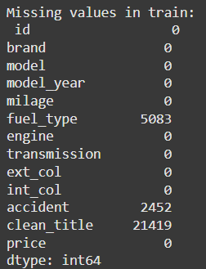
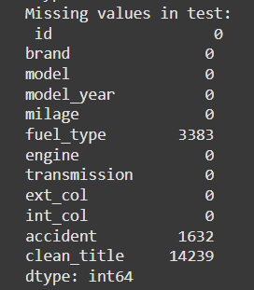
Results of missing values
As you can see from the previous slide when we used the (.isnull().sum()) function , here are the results :
In train and test dataset we have null/missing values in fuel_type , accident , clean_title columns
Now our job is to clean out these null values using specific functions or we can drop depending on our data

Slide 7
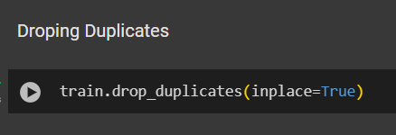
Dropping Duplicates
Removes duplicates rows in training dataset to ensure data quality and prevent biases in traing
This part is from data cleaning but we did it at first top so we can

Slide 8

02
Data Cleaning

Slide 9
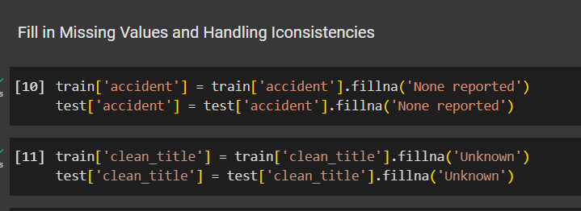
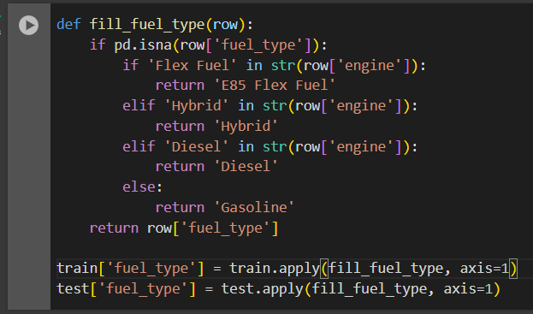
Filling in Missing Values
As a starter in Data Cleaning , we began with filling in those null values.
By using (.fillna()) function for accident and clean_title . Filling the null values with None reported and Unknown.
In the fill_fuel_type function fills missing values in the fuel_type column of datasets (train and test) based on information from the engine column. This logic ensures consistent and accurate imputation of missing fuel types based on available engine data.

Slide 10

Handling Inconsistencies
Handling inconsistencies in data involves identifying and standardizing variations in values to ensure uniformity and reliability.
Detecting Variations: Identify inconsistent formats, typos, or alternate representations of the same value
( 'BLUE', 'Blu', 'Blue').
Standardizing Values: Replace variations with a single, consistent format or category using techniques like mapping or regular expressions.
Handling Unsupported or Missing Values: Replace invalid, unsupported, or missing entries ('–', NaN) with a meaningful placeholder like 'Unknown'.

Slide 11
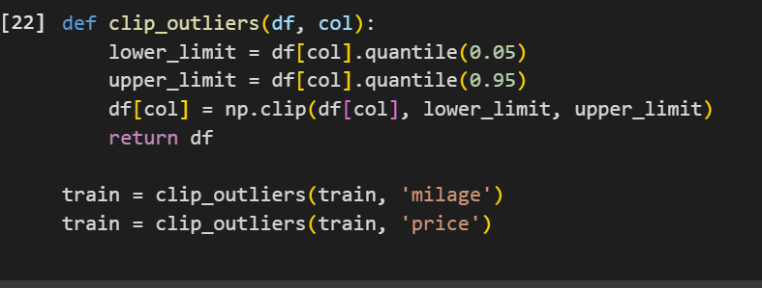
Detecting Outliers
This code handles outliers in the milage and price columns by clipping extreme values to fall within a defined range based on quantiles.
Clipping Outliers: Clips outliers in milage and price based on the 5th and 95th percentiles to reduce their impact on model training.
This technique reduces the impact of extreme outliers while retaining the overall data distribution, improving the stability and performance of machine learning models.

Slide 12

03
Visualization and Heatmap

Slide 13
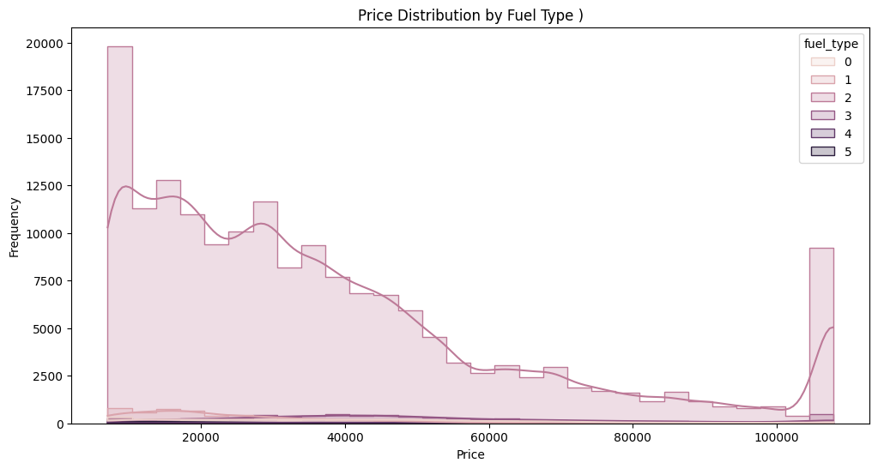
Price Distribution by Fuel Type
This graph demonstrates the distribution of car prices across various fuel types after data cleaning.
It allows us to identify trends, patterns, and anomalies specific to each fuel type.
For example, certain fuel types may have price clusters indicating affordability or rarity.
These insights are valuable for identifying market segmentation and targeting specific audiences.

Slide 14
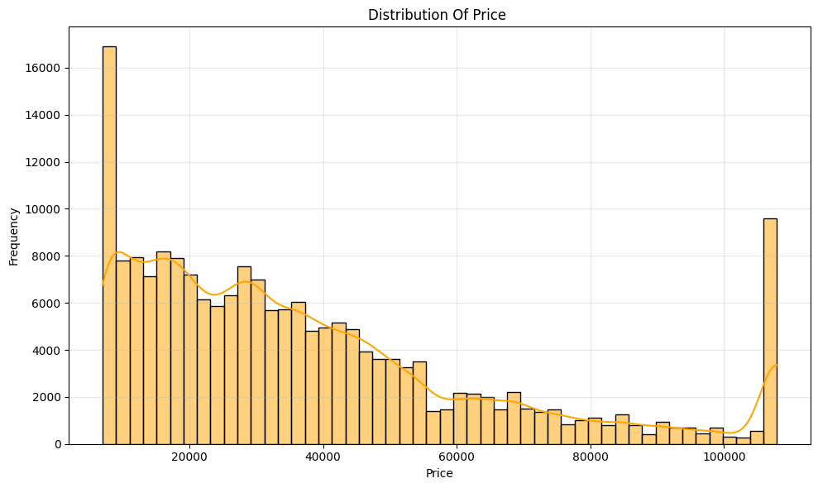
Overall Price Distribution
This histogram illustrates the overall price distribution after data cleaning.
The orange density curve highlights the spread of prices, revealing clusters of affordable and premium cars.

Slide 15
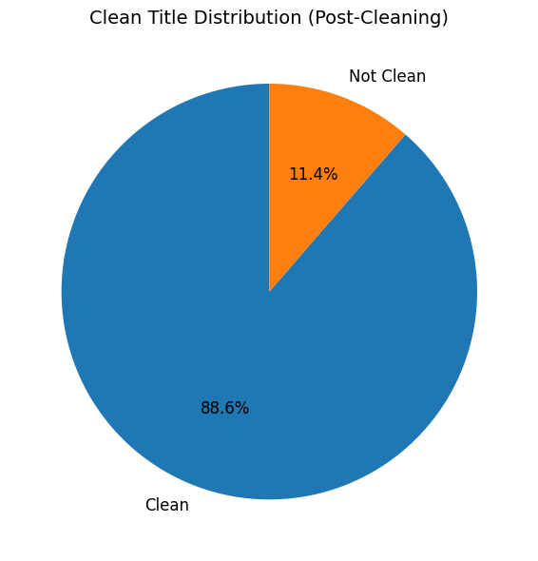
Clean Title Distribution
The pie chart shows the percentage of cars with clean and non-clean titles after cleaning.
Clean titles (88.6%): Increase consumer trust and indicate a reliable dataset.
Non-clean titles (11.4%): Appeal to niche markets with lower-cost vehicles but carry some risk.
Understanding this distribution aids in risk assessment and customer targeting strategies.
A higher percentage of clean titles indicates better-quality data, aiding accurate predictions.

Slide 16
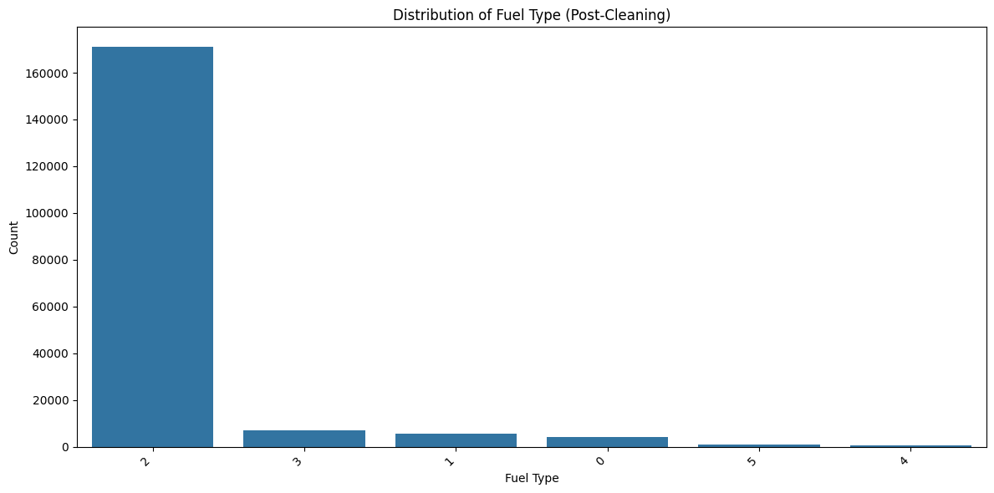
Fuel Type Distribution
This bar chart represents the distribution of various fuel types after cleaning.
It highlights the prevalence of specific fuel types, useful for understanding market trends.

Slide 17
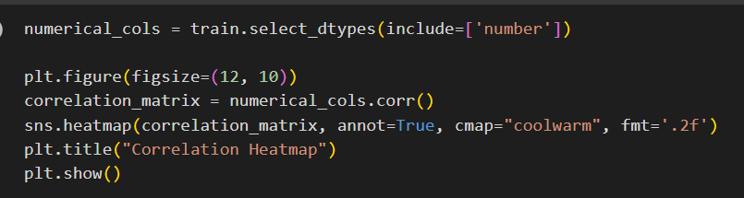
Heatmap
This code generates a heatmap to visualize the correlation between numerical features in a dataset
The correlation heatmap helps us quickly understand how features in the dataset are related. Strong correlations between variables can guide decisions on feature selection or reveal potential multicollinearity, while weaker correlations may indicate less relevant features.
his can help in identifying patterns, trends, or potential redundancies in the dataset, which is essential for feature selection and understanding data dynamics.

Slide 18
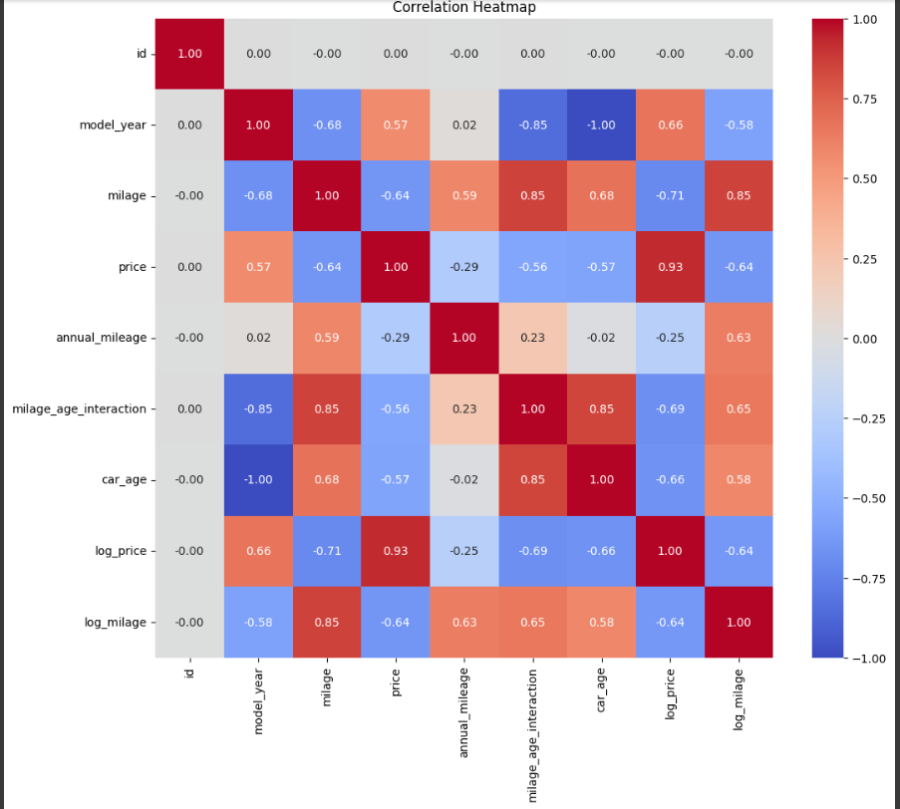

Slide 19
Explanation Heatmap
Heatmaps assist in spotting regards, tendencies and perhaps repetition in the data set.It helps in the selection of features by identifying variables that are strongly correlated ensuring that a more accurate and dependable model is obtained.Insights from the Heatmap :
1. Model year and car age together are highly negatively associated with each other (-1.00) implying that a lower model car will have higher car age.
2. Price and log price as expected show a very high positive association of 0.93 because there was a transformation of data on a logarithmic scale.
3. The mileage age interaction and mileage together exhibit a strong positive relationship with each other of 0.85 meaning that the two together are very useful to an analysis.

Slide 20

04
Feature Engineering

Slide 21
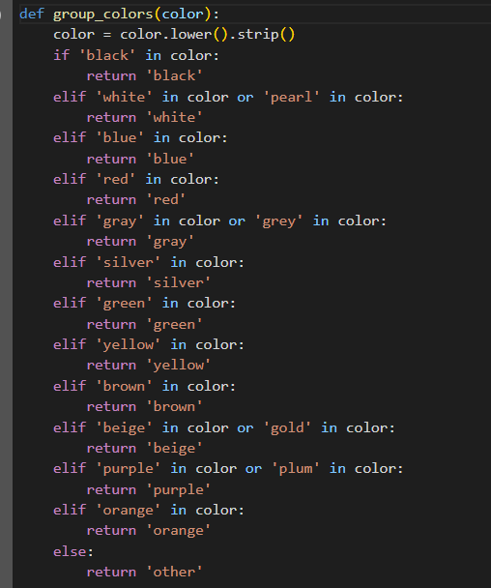
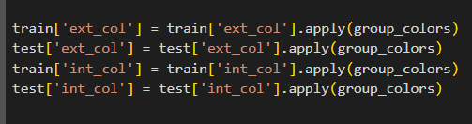
Combine related categorical values (colors)
This code defines a function group_colors that categorizes and standardizes color names in the ext_col (exterior color) and int_col (interior color) columns into common color groups.
This helps simplify the data by consolidating related color values into a smaller set of categories, making it easier for models to process and improving overall consistency.

Slide 22
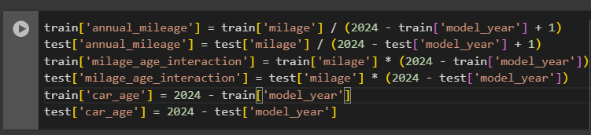
Feature Transformation
This code generates new features that combine mileage and car age information to improve the dataset.
annual_mileage: Average mileage per year based on model_year.
milage_age_interaction: Product of milage and car age.
car_age: Age of the car.
These newly created features aim to enhance the dataset by including important interactions and derived variables
which can help improve the accuracy and predictive power of the model by offering more relevant information.

Slide 23
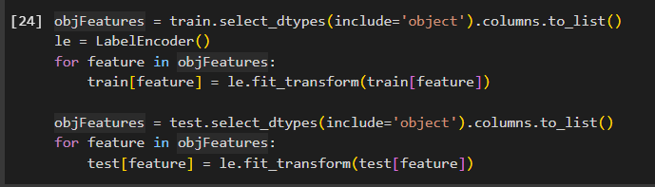
Encode categorical features
This code applies label encoding to categorical columns in the train and test datasets.
Label encoding is used to convert categorical features into numeric values so they can be used in machine learning models that require numerical input. This helps to prepare the data for model training and testing.

Slide 24
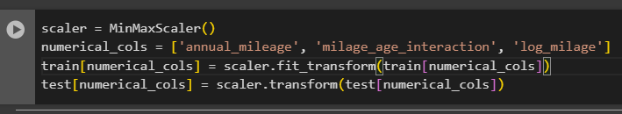
Min-Max scaling
This code applies Min-Max scaling to scale specific numerical features in the train and test datasets.
Scales numerical features like annual_mileage and milage_age_interaction to a range of 0 to 1, standardizing feature values for consistent model input.
Min-Max scaling is used to standardize the range of features, making sure they are on the same scale, which helps improve the performance of models that are sensitive especially those sensitive to the scale of the data

Slide 25
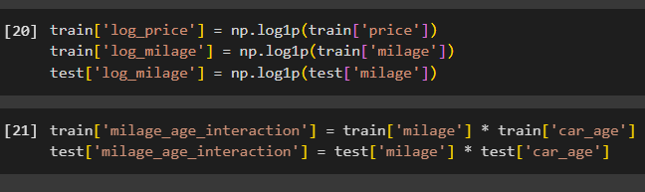
Logarithmic Transformation of Price and Mileage Features Creating a Mileage-Age Interaction
The price and milage columns are transformed using the natural logarithm (np.log1p). This reduces skewness and compresses the range of these features, making them more suitable for modeling by stabilizing variance and handling extreme values.
The logarithmic transformation improves the data distribution, making it easier for models to interpret.
A new feature, milage_age_interaction, is created by multiplying the milage and car_age columns. This interaction term captures the combined effect of a car's mileage and its age, which could be an important predictor for the target variable, such as the car's price or condition.
The interaction feature enhances the model by considering the combined impact of both mileage and age on the car's price or other outcomes.

Slide 26

05
Machine Learning

Slide 27

Feature-Target Splitting
Splitting the Data
This line of code splits the dataset into training and validation sets, which is a common step in preparing data for machine learning
Splitting the dataset helps avoid over fitting by testing the model on data it hasn't seen during training. This ensures the model's performance isn't just memorization but reflects its ability to generalize
This code prepares the data by separating features (independent variables) and the target (dependent variable) for a machine learning task
Features: Prepares the independent variables for model input.
Target: Isolates the dependent variable (log_price) that the model will learn to
predict.

Slide 28
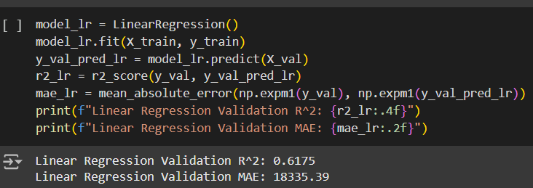
Linear Regression
Linear Regression model, evaluates its performance, and calculates key metrics to assess its predictive ability.
Purpose: Evaluate a Linear Regression model on a validation set.
R² Score: Measures the proportion of variability in the target explained by the model.
MAE: Reports the average error in monetary terms (post-log transformation).
Insights: These metrics provide a quick and interpretable view of model performance, allowing comparison with other models.

Slide 29
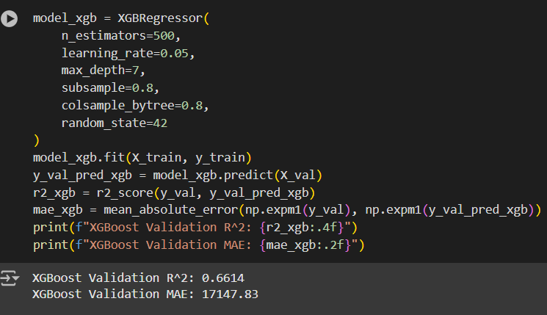
XGBoost
XGBoost Regression Model, evaluates its performance on the validation set, and calculates key metrics for interpretation. XGBoost, a high-performing gradient boosting algorithm.
Parameters like tree depth, learning rate, and sampling ratios are adjusted to balance complexity and over fitting.
This evaluation provides a benchmark to assess XGBoost's performance against other models, highlighting its strengths in accuracy and robustness.

Slide 30
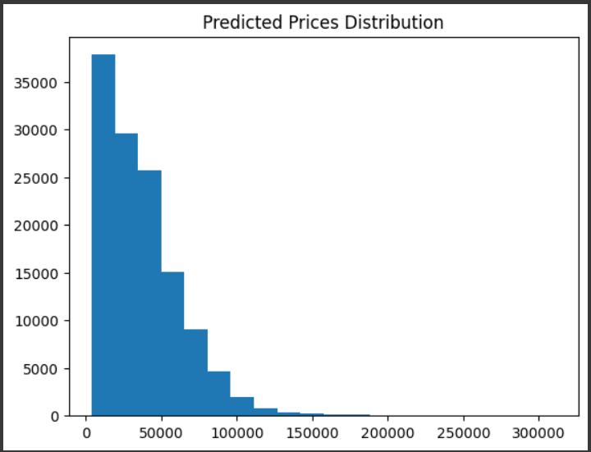
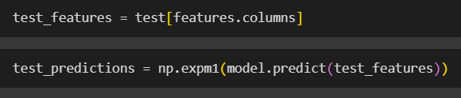
predictions on the test dataset using the selected model and transforms the predictions back to the original scale of the target variable (price).
Visualization of predicted Prices
To generate predictions for the test set in the same scale as the original target variable, making the results interpretable in terms of actual prices.
To analyze the spread and shape of the predicted price values.
Helps identify patterns or anomalies
( clustering, outliers, or skewed distributions)

Slide 31

06
Accuracy

Slide 32
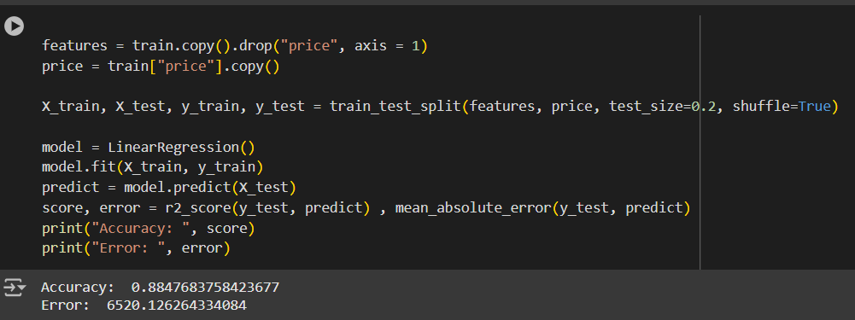
Accuracy
Linear Regression model on a split of the dataset, evaluates its performance, and reports the accuracy (R² score) and error (MAE).
Accuracy (R² Score): Indicates how well the model fits the test data.
Error (MAE): Represents the average prediction error in monetary terms (interpretable for stakeholders).
Purpose: This process evaluates the model's ability to generalize to unseen data, providing a baseline for further comparisons or refinements.

Slide 33
THANK YOU
If you have any question don’t hesitate to ask
This project was presented by:
Zeina Al-Shalaby
Layan Abandah
Zaid Abdullah
Supervised by :
Omar Al Qwasmeh

